Slide 1
基于Linux操作系统和龙芯SOC
的应用与开发
第十讲 嵌入式 Linux
操作系统外设6-PWM接口操作
南京工业大学 孙冬梅

Slide 2
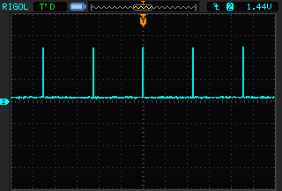
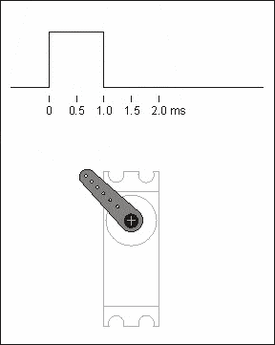
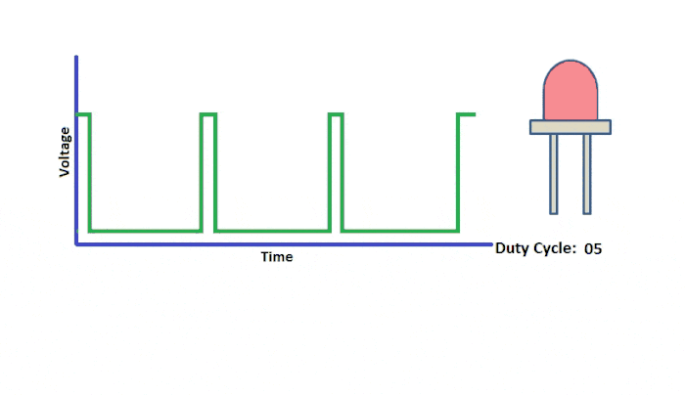
第十讲嵌入式 Linux外设6-PWM接口操作
1. LED_PWM
2. PWM驱动模块
3. 测试驱动模块

Slide 3
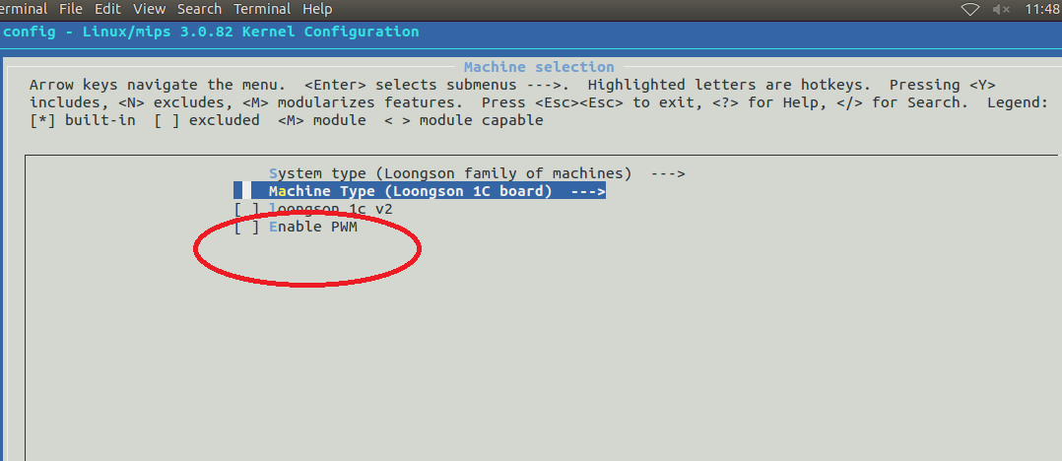
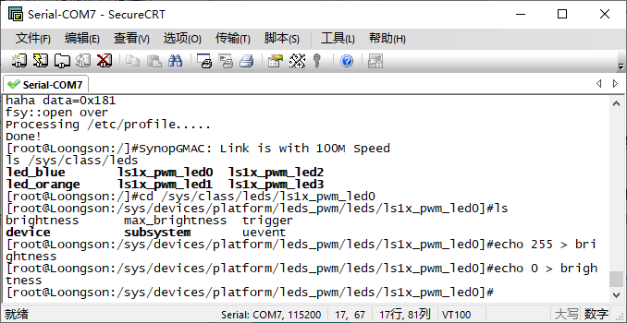
1. LED_PWM
LED_PWM 已经配置在内核中
平台文件增加设备成功
Ls1x_pwm_led0~led3
echo 255 > brightness
echo 0 > brightness

Slide 4
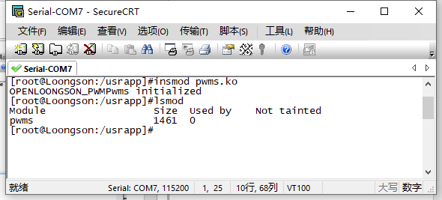
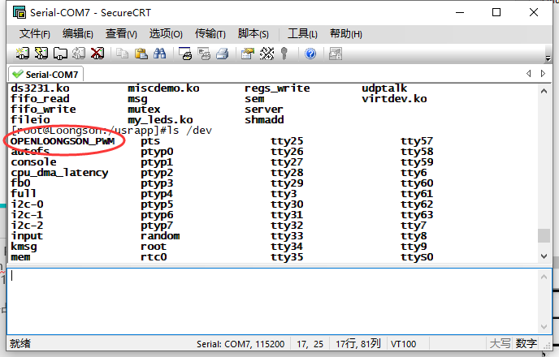
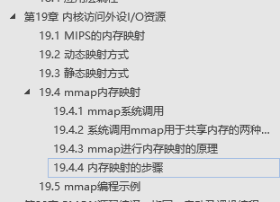
2. PWM 驱动模块
static int __init Loongson_pwm_init(void)
{
int ret;
long val = readl(REG_GPIO_CFG0);
val &= 0xffffffbf;
writel(val, REG_GPIO_CFG0);
val = readl(REG_GPIO_CFG0);
val &= 0xefffffff;
writel(val, REG_GPIO_CFG2);
val = readl(CBUS_SECOND4);
val |= 0x0000C000;
writel(val, CBUS_SECOND4);
ret = misc_register(&misc);
printk (DEVICE_NAME"Pwms initialized\n");
return ret;
}
基于杂项设备驱动编写PWM驱动模块
pwms.c
入口函数
GPIO6 92 46 47 为 PWM
注册 设备。
Loongson_pwm_ioctl函数
实现配置PWM 的通道和数值
if(arg>100)
arg = 100;
data[0] = freq / 100 * arg;
data[1] = freq / 100 * (100-arg);
hrc_val = data[1] - 1;
lrc_val = data[0] + data[1] -1;
printk("hrc:%i ; lrc:%i\n",hrc_val,lrc_val);
pwm_base = ioremap(PWM_BASE, 4);
writel(0x0, pwm_base + REG_PWM_CNTR);
writel(0x01, pwm_base + REG_PWM_CTRL);
writel(hrc_val, pwm_base + REG_PWM_HRC);
writel(lrc_val, pwm_base + REG_PWM_LRC);
printk("ls1c_pwm0 write!\n");
iounmap( pwm_base );

Slide 5
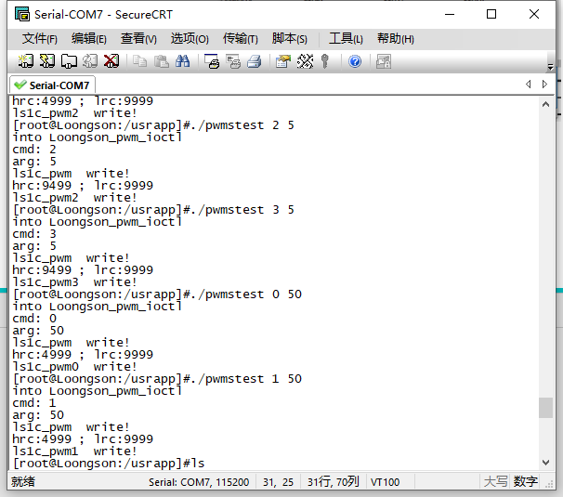
3. 测试驱动模块
编写代码测试PWM驱动模块.
int main(int argc, char **argv)
{
int pwm_value;
int pwm_no;
int fd;
if (argc != 3 || sscanf(argv[1], "%d", &pwm_no) != 1 || sscanf(argv[2],"%d", &pwm_value) != 1 ||
pwm_no < 0 || pwm_no > 3)
{
printf("Usage: pwmstest pwm_no pwm%\n");
return -1;
}
fd = open("/dev/OPENLOONGSON_PWM", 0);
if (fd < 0)
{
printf("Can not open pwms\n");
return -1;
}
ioctl(fd, pwm_no , pwm_value);
close(fd);
return 0;
}

Slide 6
感谢聆听！！
THANKS
基于自主可控基础软硬件的嵌入式系统教学
助力 国产芯片 国产操作系统 嵌入式系统开发！！！

